Slide 1
Covert Channels:
Hiding Data In Plain Sight
Capt Daniel Fitzgerald
21 JUL 2025
This document is for information only. No U.S. Government commitment to sell, loan, lease, co-develop or co-produce defense articles or services is implied or intended.
DISTRIBUTION A: Approved for Public Release; Distribution Unlimited: 88ABW-2020-197

Slide 2
whoami

Slide 3
Overview
What are Covert Channels?
Networking Review
Wireshark Review
Types of Covert Channels
Casual vs Dedicated Observer
Evaluating Covert Channels
Detection
Cobalt Strike Integration
Practice

Slide 4
What are Covert Channels?

Slide 5
What are Covert Channels?
Exercise0.pcap
Notes:
Slide hidden due to poor reception of exercise 0 in previous years.
~10min
Wannacry.pcap
Look for DOUBLE PULSAR covert channel in SMB traffic
“smb.mid == 81”
https://www.forcepoint.com/blog/x-labs/evasions-used-shadow-brokers-tools-danderspritz-and-doublepulsar-part-2-2
https://zerosum0x0.blogspot.com/2017/04/doublepulsar-initial-smb-backdoor-ring.html
https://www.bleepingcomputer.com/news/security/wana-decrypt0r-ransomware-using-nsa-exploit-leaked-by-shadow-brokers-is-on-a-rampage/
https://arstechnica.com/information-technology/2019/05/stolen-nsa-hacking-tools-were-used-in-the-wild-14-months-before-shadow-brokers-leak/
https://blog.talosintelligence.com/2017/05/wannacry.html
WannaCry
Ransomeware cryptoworm – May 2017 – 200,000+ computers, 150 countries, damages of $100,000,000 - $1,000,000,000 – Believed to be from N.Korea
DoublePulsar – backdoor tool -

Slide 6
What are Covert Channels?
Covert Channels
Unforeseen communication methods that break security policies.
Network Covert Channels
Transfer information through networks in ways that hide the fact that communication takes place.
Used in scenarios where normal communication is too revealing and just using encryption is not sufficient.
Where to hide data?
[Wendzel 2014] Updated 2016, 2018, 2019, 2021
Notes:
https://ih-patterns.blogspot.com/p/test.html

Slide 7
What are Covert Channels?
Covert Channels
Unforeseen communication methods that break security policies.
Network Covert Channels
Transfer information through networks in ways that hide the fact that communication takes place.
Used in scenarios where normal communication is too revealing and just using encryption is not sufficient.
Where to hide data?
Covert Timing Patterns
Covert Storage Patterns
[Wendzel 2014] Updated 2016, 2018, 2019, 2021
Notes:
https://ih-patterns.blogspot.com/p/test.html
[1] S. Wendzel, S. Zander, B. Fechner, C. Herdin: Pattern-based Survey and Categorization of Network Covert Channel Techniques, ACM Computing Surveys, Vol. 47, Issue 3, pp. 50:1-26, ACM, 2015. An early version of the article is available here: download. [2] W. Mazurczyk, S. Wendzel, S. Zander, A. Houmansadr, K. Szczypiorski: Information Hiding in Communication Networks, Wiley, 2016. Chapters 3 and 8 contain discussions on hiding patterns, basically on the basis of [1] but with an extension of timing-based patterns. [3] W. Mazurczyk, S. Wendzel, K. Cabaj: Towards Deriving Insights into Data Hiding Methods Using Pattern-based Approach, in Proc. Second International Workshop on Criminal Use of Information Hiding (CUING 2018) at ARES, pp. 10:1-10:10, ACM, 2018.
[4] A. Velinov, A. Mileva, S. Wendzel, W. Mazurczyk: Covert Channels in MQTT-based Internet of Things, IEEE ACCESS, Vol. 7, pp. 161899-161915, 2019.
[5] A. Mileva, A. Velinov, L. Hartmann, S. Wendzel, W. Mazurczyk: Comprehensive Analysis of MQTT 5.0 Susceptibility to Network Covert Channels, Computers & Security, Elsevier, 2021.
[6] L. Hartmann, S. Zillien, S. Wendzel: Reset- and Reconnection-based Covert Channels in CoAP. In: Proc. European Interdisciplinary Cybersecurity Conference (EICC), 2021.

Slide 8
What are Covert Channels?
Mechanism for sending information without the knowledge of the network admin or other users
Often data is passed in plain sight
Why not just encrypt?

Slide 9
What are Covert Channels?
Mechanism for sending information without the knowledge of the network admin or other users
Often data is passed in plain sight
Why not just encrypt?
Suspicious
Obscure the fact a channel exists
Outlawed
Flawed
Attributable

Slide 10
What are Covert Channels?
Use cases?

Slide 11
What are Covert Channels?
Use cases?
Exfil data
Avoid detection
Malware
Bypass filters and firewalls
How?
Create misuse within scope/limitations of protocol RFC
Encapsulate banned protocols within allowed ones

Slide 12
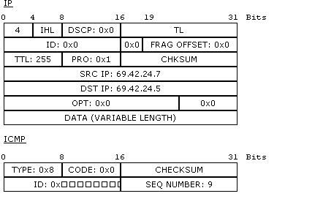
What are Covert Channels?
Quick Example – Ping
https://tools.ietf.org/html/rfc792
Photo:https://upload.wikimedia.org/wikipedia/commons/d/dd/Conteudo_de_um_PDU.png Author: Rodrigozanatta License: Public Domain

Slide 13
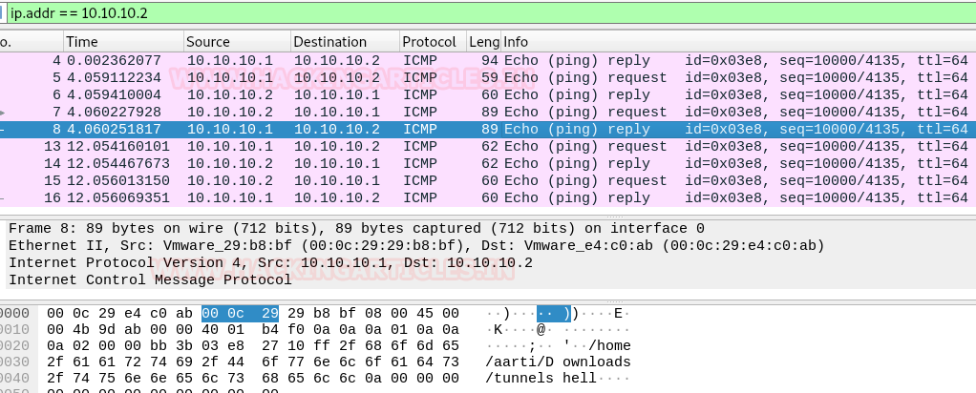
What are Covert Channels?
Screen shot of Exercise 1
Screen shot of Exercise 1

Slide 14
Networking Review
Why do we care?

Slide 15
Practice
Exercise1.pcap
ReviewQuestions.txt

Slide 16
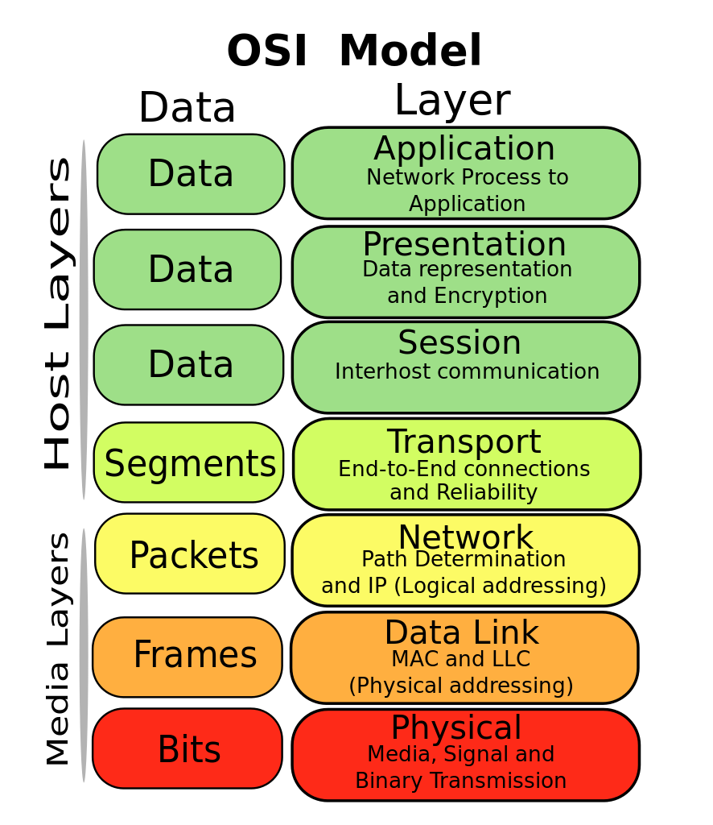
Networking Review
HTTP, DNS, FTP
Recognizing data
Session
establishment
TCP, UDP
IP, ARP
Ethernet, 802.11
https://upload.wikimedia.org/wikipedia/commons/thumb/4/47/Osi-model-jb.svg/886px-Osi-model-jb.svg.png
Author:Gorivero
License: Creative Commons 3.0
Rj45, 802.11

Slide 17
Networking Review
HTTP, DNS, FTP
Recognizing data
Session
establishment
TCP, UDP
IP, ARP
Ethernet, 802.11
https://upload.wikimedia.org/wikipedia/commons/thumb/4/47/Osi-model-jb.svg/886px-Osi-model-jb.svg.png
Author:Gorivero
License: Creative Commons 3.0
Rj45, 802.11
Notes:
https://upload.wikimedia.org/wikipedia/commons/thumb/4/47/Osi-model-jb.svg/886px-Osi-model-jb.svg.png

Slide 18
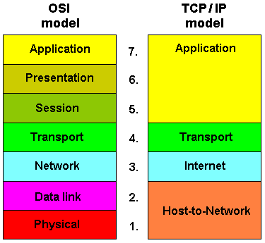
Networking Review
https://upload.wikimedia.org/wikipedia/commons/8/8f/OSIandTCP.gif Author: Marinanrtd2014 License: Creative Commons 4.0

Slide 19
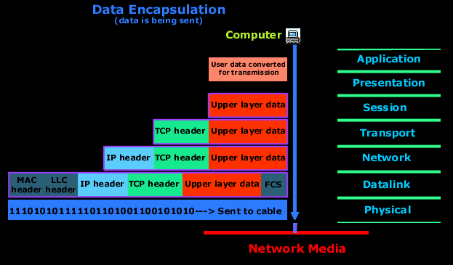
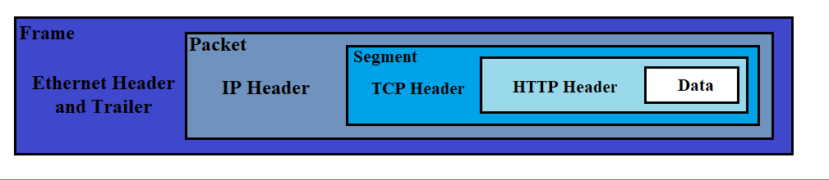
Networking Review
https://upload.wikimedia.org/wikipedia/commons/a/a9/Encapsulation_-_en.png
https://upload.wikimedia.org/wikipedia/commons/6/6c/Osi-encapsulation.gif Author: Moeenrahi License: Creative Commons 4.0
https://upload.wikimedia.org/wikipedia/commons/a/a9/Encapsulation_-_en.png
Author: Michel Bakni License: Creative Commons 4.0

Slide 20
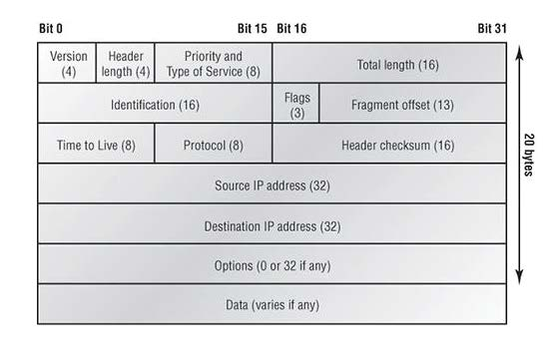
Networking Review
Photo:https://upload.wikimedia.org/wikipedia/commons/0/00/Ip_pic.jpg Author: BenJerry137 License: Creative Commons 3.0

Slide 21
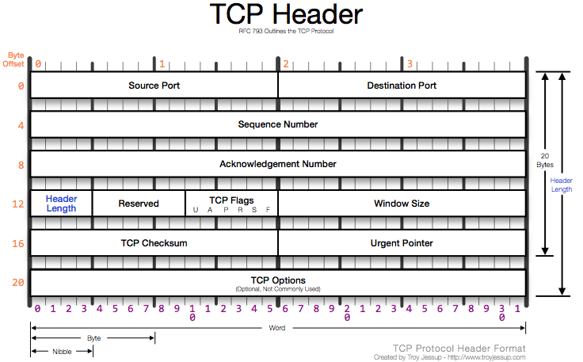
Networking Review
Photo:https://upload.wikimedia.org/wikipedia/commons/4/4e/TCP_Protocol_Diagram.png Author: Tjhiker License: Creative Commons 3.0

Slide 22
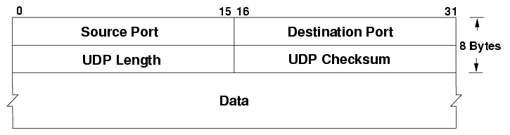
Networking Review
Photo:https://upload.wikimedia.org/wikipedia/commons/0/0c/UDP_header.png Author: Ere License: public domain

Slide 23
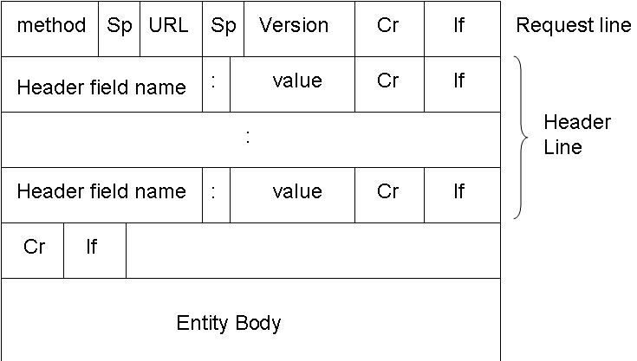
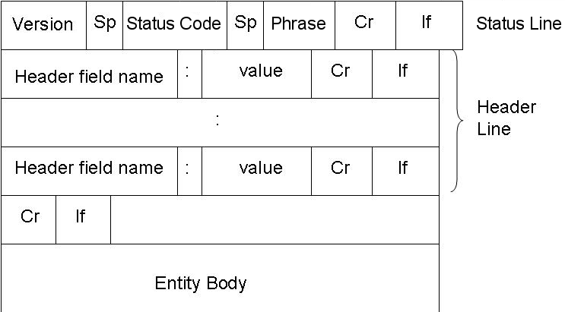
Networking Review
https://upload.wikimedia.org/wikipedia/commons/5/5b/Prj5.jpeg
License: Creative Commons 2.5
HTTP Request
HTTP Response
https://upload.wikimedia.org/wikipedia/commons/2/28/Prj5-responseHeader.png
License: Creative Commons 2.5
Also see: http://www.tcpipguide.com/free/t_toc.htm

Slide 24
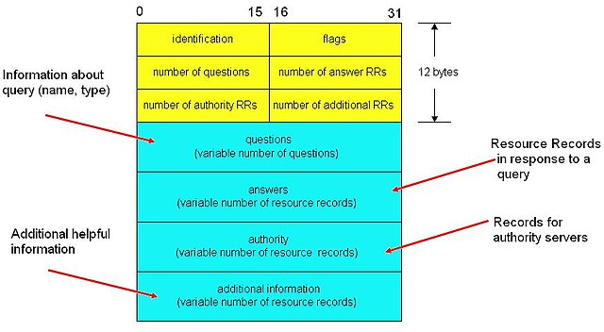
Networking Review
Photo: https://upload.wikimedia.org/wikipedia/commons/thumb/4/40/Dns_message.jpg/640px-Dns_message.jpg Author: Richard Bhuleskar License by Creative Commons 2.5
DNS
Also see: http://www.tcpipguide.com/free/t_toc.htm

Slide 25
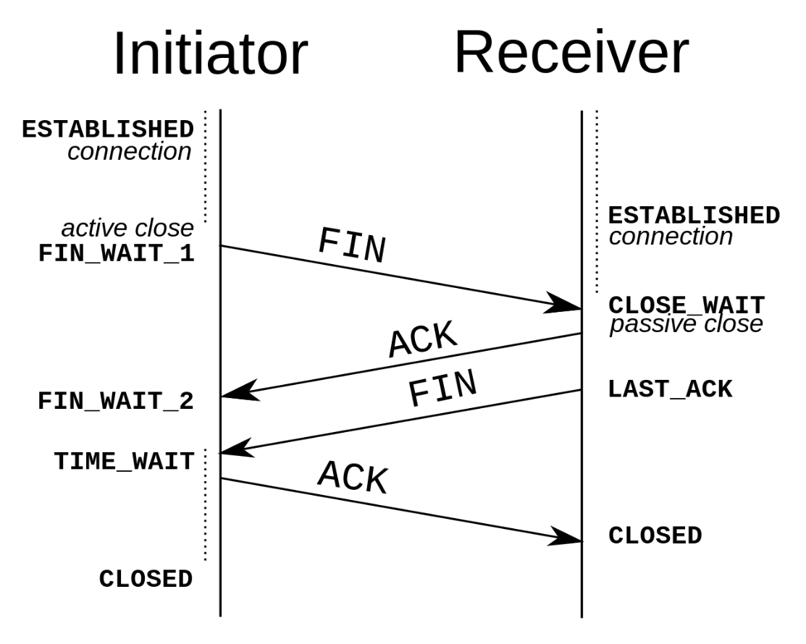
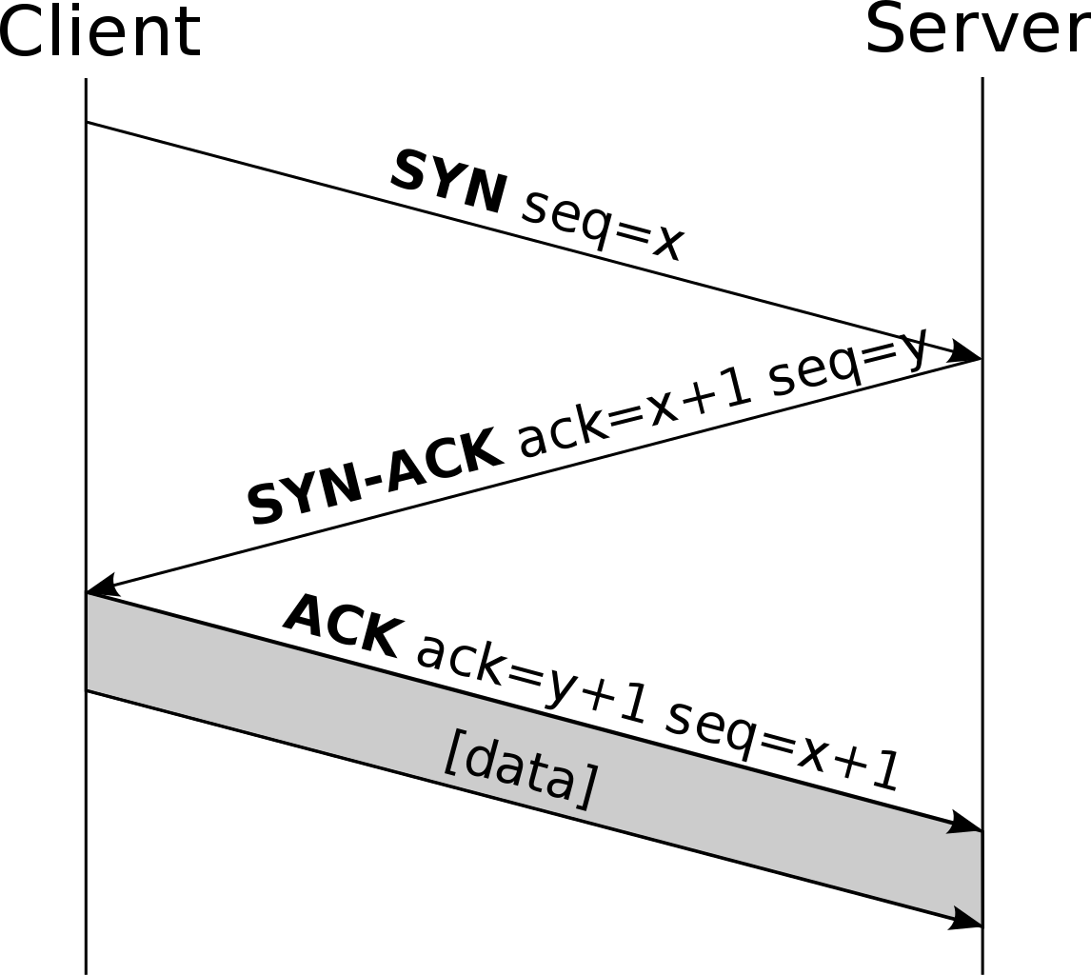
Networking Review
https://upload.wikimedia.org/wikipedia/commons/thumb/9/98/Tcp-handshake.svg/1146px-Tcp-handshake.svg.png
https://upload.wikimedia.org/wikipedia/commons/thumb/5/55/TCP_CLOSE.svg/1280px-TCP_CLOSE.svg.png
License: Creative Commons 3.0

Slide 26
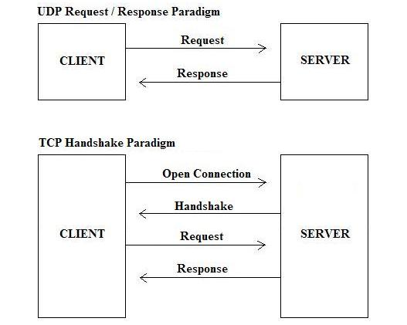
Networking Review
Photo:https://upload.wikimedia.org/wikipedia/commons/b/b1/UDP_Connections.jpg
Author: Khandarmaa License: Creative Commons 4.0

Slide 27
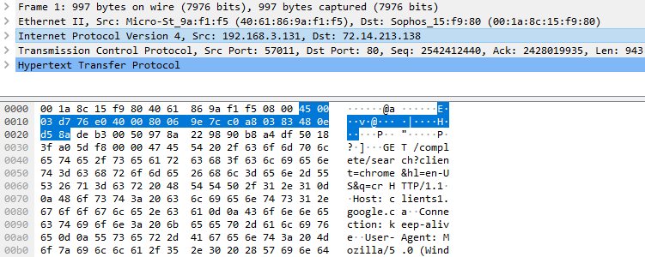
Networking Review
Screen shot of Exercise 1

Slide 28
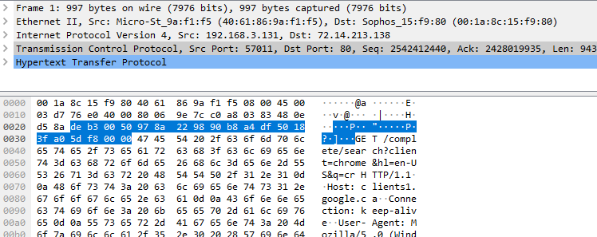
Networking Review
Screen shot of Exercise 1

Slide 29
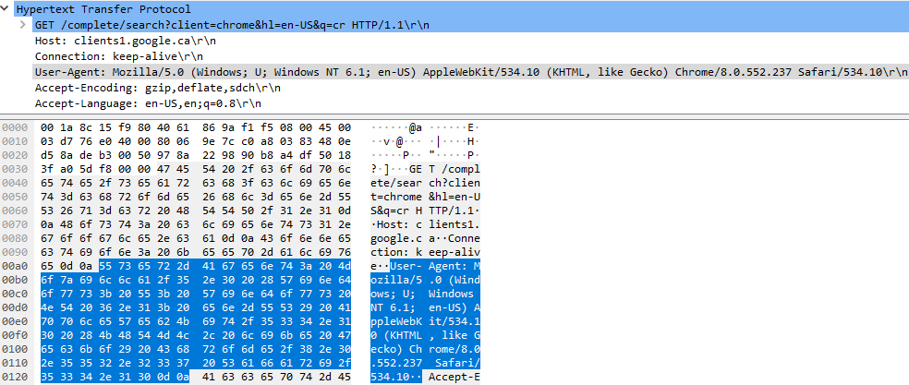
Networking Review
Screen shot of Exercise 1

Slide 30
Networking Review
Photo:https://upload.wikimedia.org/wikipedia/commons/0/00/Ip_pic.jpg Author: BenJerry137 License: Creative Commons 3.0
Also see: http://www.tcpipguide.com/free/t_toc.htm

Slide 31
Wireshark Review
Select the correct interface
Promiscuous vs normal
Filtering
http.request.method == “GET”
tcp.port == XXX and data
ip.src == x.x.x.x and tcp.flags.ack == 1 and data and tcp.flags.push == 0
http and (ip.src != x.x.x.x && ip.src != y.y.y.y)
data-text-lines contains “string”
http.content_type == “application/octet-stream”
!( (ip.dst == x.x.x.x) || (ip.src == y.y.y.y) )
ip.addr != x.x.x.x VS !(ip.addr == x.x.x.x)

Slide 32
Wireshark Review
Follow TCP Stream
Export data / extract files
SSL/TLS Decryption with keys
Statistics
Protocol Hierarchy
Conversations
Packet Lengths
IP/TCP/HTTP Statistics
Marking packets (Ctrl+M or Ctrl+Shift+M)
Ignoring packets (Ctrl+D)
https://www.wireshark.org/docs/wsug_html_chunked/

Slide 33
Practice
Exercise2.pcap
https://drive.google.com/file/d/1VwjsAJV2Z2drE9vC_g2J_Snjz8WYtN5B/view?usp=sharing
NormalPCAP/
Notes:
10 min
bigFlows.pcap
Pick a protocol and lookup the RFC
Does the protocol in the pcap match the RFC?
https://drive.google.com/file/d/1VwjsAJV2Z2drE9vC_g2J_Snjz8WYtN5B/view?usp=sharing

Slide 34
Types of Covert Channels
Storage vs Timing Channels
Network vs Local Covert Channels
Active vs Piggyback Channels
Structured vs Unstructured Channels
Which is best?
Adversary Scenario: Simmons Prisoner’s Problem [Simmons 1983]
Warden can read, reject, manipulate, or inject messages
Active vs passive warden (Obstruct vs observe)

Slide 35
Practice
Exercise3 – client/server.pcap
Exercise4.pcap
Exercise5.pcap

Slide 36
Examples
IPv4 Header
Photo:https://upload.wikimedia.org/wikipedia/commons/0/00/Ip_pic.jpg Author: BenJerry137 License: Creative Commons 3.0

Slide 37
Examples
IPv4 Header
Photo:https://upload.wikimedia.org/wikipedia/commons/0/00/Ip_pic.jpg Author: BenJerry137 License: Creative Commons 3.0

Slide 38
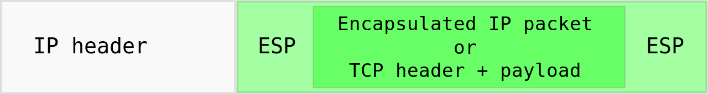
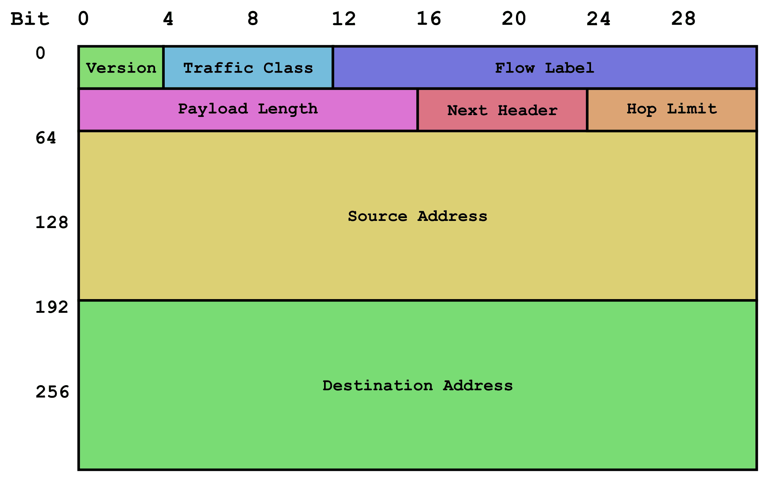
Examples
IPSec?
IPv6?
Extension Headers?
Addresses?
Photo: https://upload.wikimedia.org/wikipedia/commons/thumb/3/3f/Ipsec-esp.svg/1280px-Ipsec-esp.svg.png Author: Mbakhoff License: public domain
Photo: https://upload.wikimedia.org/wikipedia/commons/6/6b/IPv6_header_rv1.png License: Creative Commons 3.0
Extension Header

Slide 39
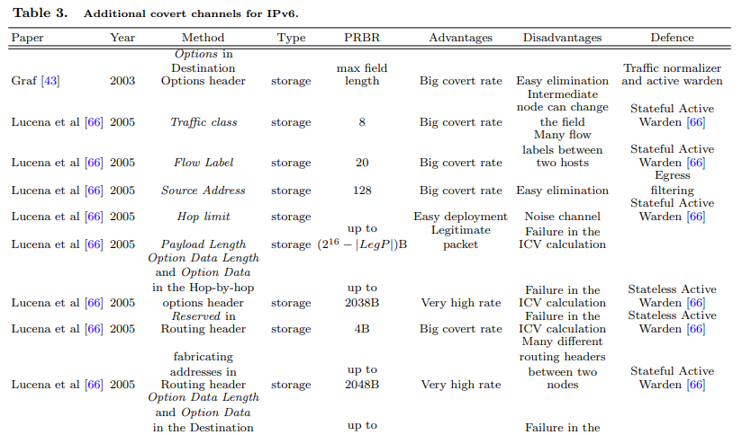
Examples
https://core.ac.uk/download/pdf/35336502.pdf
See Table 3 for IPv6 covert channels

Slide 40
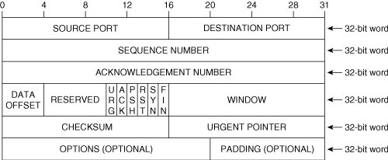
Examples
TCP Header
Photo: https://upload.wikimedia.org/wikipedia/commons/8/82/Tcp_segmenti.jpg Author: Albionaberisha License: Creative Commons 4.0

Slide 41
Examples
TCP Header
Photo: https://upload.wikimedia.org/wikipedia/commons/8/82/Tcp_segmenti.jpg Author: Albionaberisha License: Creative Commons 4.0

Slide 42
Examples
URG Pointer
Points to first data octet following urgent data
Only valid if URG flag is set
16 bits per TCP header/packet
Easy to detect
Easy to prevent
Easy to implement

Slide 43
Examples
TCP Header
Photo: https://upload.wikimedia.org/wikipedia/commons/8/82/Tcp_segmenti.jpg Author: Albionaberisha License: Creative Commons 4.0

Slide 44
Examples
Padding/Reserved Bits
Any spot that is not being used
1st bit of IP Flags (evil bit)
IP options
4 reserved bits of TCP header
TCP options
Lower bandwidth than URG pointer
Easy to detect
Easy to prevent
Easy to implement

Slide 45
Examples
IPv4 Header
Photo:https://upload.wikimedia.org/wikipedia/commons/0/00/Ip_pic.jpg Author: BenJerry137 License: Creative Commons 3.0
https://nmap.org/book/tcpip-ref.html

Slide 46
Examples
IP Type of Service
Indicates the quality of service requested (delay/precedence/reliability…)
Never really been used
Either set whole byte or just the delay bit to be more stealthy
Easy to moderate to detect
Easy to prevent
Easy to implement

Slide 47
Examples
IPv4 Header
Photo:https://upload.wikimedia.org/wikipedia/commons/0/00/Ip_pic.jpg Author: BenJerry137 License: Creative Commons 3.0

Slide 48
Examples
Initial Sequence Number
Sequence numbers used to index TCP packets
Initial number should be random to prevent TCP session hijacking and spoofing
Following numbers are sequential
Hide data in initial sequence number – 32 bits per TCP connection
‘Impossible’ to detect
Difficult to prevent
Moderate difficulty to implement

Slide 49
Examples
TCP Header
Photo: https://upload.wikimedia.org/wikipedia/commons/8/82/Tcp_segmenti.jpg Author: Albionaberisha License: Creative Commons 4.0

Slide 50
Practice
Exercise6.pcap
Exercise7.pcap

Slide 51
Examples
Timing Channel
Passes information by using the speed at which things happen
Use normal and accepted methods but abnormal or specific times
Heavy or light use of a shared resource
Hard to ‘impossible’ to detect
Somewhat hard to prevent
Hard to implement

Slide 52
Examples
Domain Name System (DNS)
Translates IP addresses to domain names
Allowed through most firewalls
‘A’ record – Return IP associated with domain name
‘CNAME’ record – returns alias for given host
‘NS’ record – returns IP of authoritative name server
Able to request xxxx.yyyy.zzzz.domain.com
Could return data in B64 encoded TXT records
Still need to get around cache – poison
Dan Kaminsky - OzymanDNS

Slide 53
Examples
DNS Header
Photo: https://upload.wikimedia.org/wikipedia/commons/thumb/4/40/Dns_message.jpg/640px-Dns_message.jpg Author: Richard Bhuleskar License by Creative Commons 2.5

Slide 54
Examples
Exercise12.pcap

Slide 55
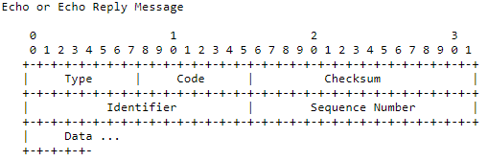
Examples
Internet Control Message Protocol (ICMP)
Used for sending control and error messages
Includes ping and traceroute (echo request/reply)
Used to fly under the radar – Loki -> ptunnel
Attach data to ping packet by using –p (LINUX)
Screenshot from ICMP RFC

Slide 56
Examples
Exercise8.pcap

Slide 57
Examples
Steganography
Art & science of writing hidden messages in a way that no one, apart from sender/recipient, suspects the existence of the message, a form of security through obscurity.
Greek – “Concealed writing”
Pictures, audio, text, files
Steganalysis
Steghide, StegoDetect, OpenStego, OutGuess

Slide 58
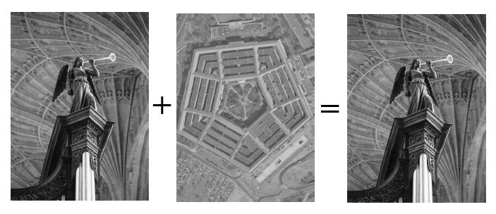
Examples
Photo: https://upload.wikimedia.org/wikipedia/commons/a/a2/Lsb-example.JPG Author: ribagorda garnacho License Creative Commons 3.0

Slide 59
Examples
Photo: https://upload.wikimedia.org/wikipedia/commons/a/a2/Lsb-example.JPG Author: ribagorda garnacho License Creative Commons 3.0

Slide 60
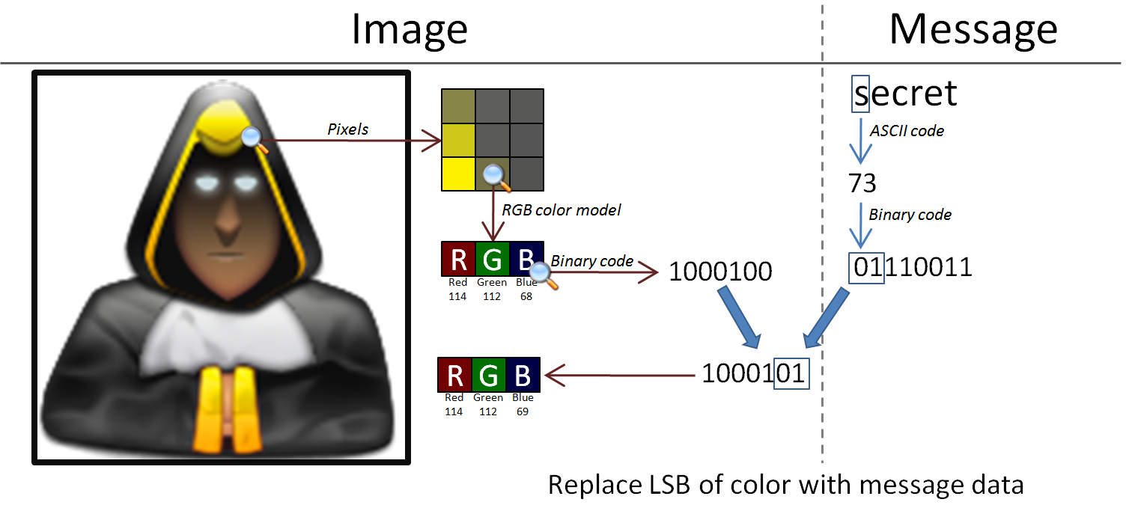
Examples
Photo: https://upload.wikimedia.org/wikipedia/commons/b/b8/Seformatbmp-embedding_full.png author Darkrezus. License: Creative Commons 3.0

Slide 61
Stego Practice
Stego1.png
Stego2.png
Stego3.png
Stego4.jpg
Stego5.png
https://georgeom.net/StegOnline/upload

Slide 62
Questions?
Capt Daniel Fitzgerald

Slide 63
Main References
Covert Channel SANS White Paper [Couture 2010]
https://www.sans.org/reading-room/whitepapers/detection/covert-channels-33413
Pattern-based Survey and Categorization of Network Covert Channels [Wendzel 2015]
https://arxiv.org/pdf/1406.2901.pdf
Updated here: https://ih-patterns.blogspot.com/p/test.html
Work by Wendzel
https://www.wendzel.de/
Google
Creativecommons.org/licenses
Notes:
[1] S. Wendzel, S. Zander, B. Fechner, C. Herdin: Pattern-based Survey and Categorization of Network Covert Channel Techniques, ACM Computing Surveys, Vol. 47, Issue 3, pp. 50:1-26, ACM, 2015. An early version of the article is available here: download. [2] W. Mazurczyk, S. Wendzel, S. Zander, A. Houmansadr, K. Szczypiorski: Information Hiding in Communication Networks, Wiley, 2016. Chapters 3 and 8 contain discussions on hiding patterns, basically on the basis of [1] but with an extension of timing-based patterns. [3] W. Mazurczyk, S. Wendzel, K. Cabaj: Towards Deriving Insights into Data Hiding Methods Using Pattern-based Approach, in Proc. Second International Workshop on Criminal Use of Information Hiding (CUING 2018) at ARES, pp. 10:1-10:10, ACM, 2018.
[4] A. Velinov, A. Mileva, S. Wendzel, W. Mazurczyk: Covert Channels in MQTT-based Internet of Things, IEEE ACCESS, Vol. 7, pp. 161899-161915, 2019.
[5] A. Mileva, A. Velinov, L. Hartmann, S. Wendzel, W. Mazurczyk: Comprehensive Analysis of MQTT 5.0 Susceptibility to Network Covert Channels, Computers & Security, Elsevier, 2021.
[6] L. Hartmann, S. Zillien, S. Wendzel: Reset- and Reconnection-based Covert Channels in CoAP. In: Proc. European Interdisciplinary Cybersecurity Conference (EICC), 2021.

